Slide 1
HOUSING PROJECT
- HARSHIL GORADIA

Slide 2
Business Project Statement :
Houses are one of the necessary needs of each person around the globe and therefore housing and real estate market is one of the markets which is one of the major contributors in the world’s economy.
It is a very large market and there are various companies working in the domain.
Data science comes as a very important tool to solve problems in the domain to help the companies increase their overall revenue, profits, improving their marketing strategies and focusing on changing trends in house sales and purchases. In this project we need to predict the prices of houses using Machine Learning.

Slide 3
EDA :
Firstly, I went through the dataset after importing into the jupyter notebook.
I checked correlation of variables and found that nearly all the variables are good enough to predict the target variable.
I delt with missing values and handled null values of numerical variables and categorical variables.
To move ahead, I visualized different features to learn dataset better and select features for modelling.
I later normalized the dataset by using ‘np_log’.

Slide 4
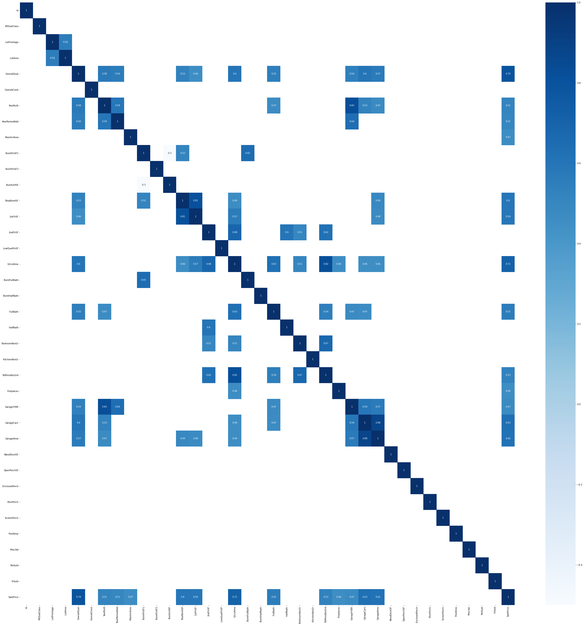
Visualization:

Slide 5
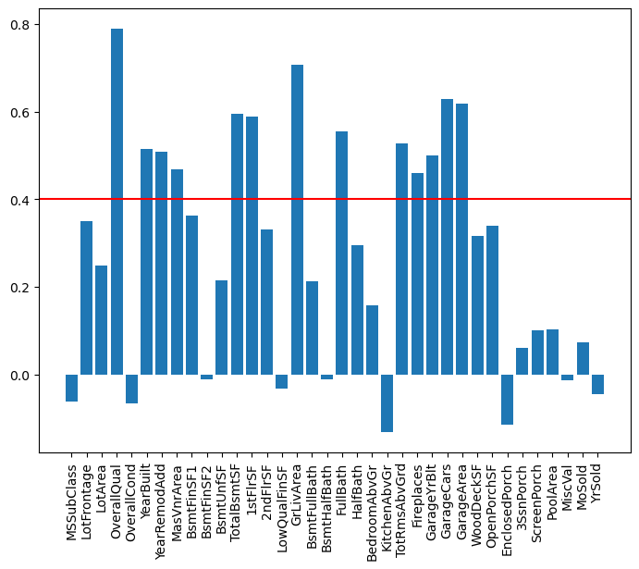
Correlation :

Slide 6
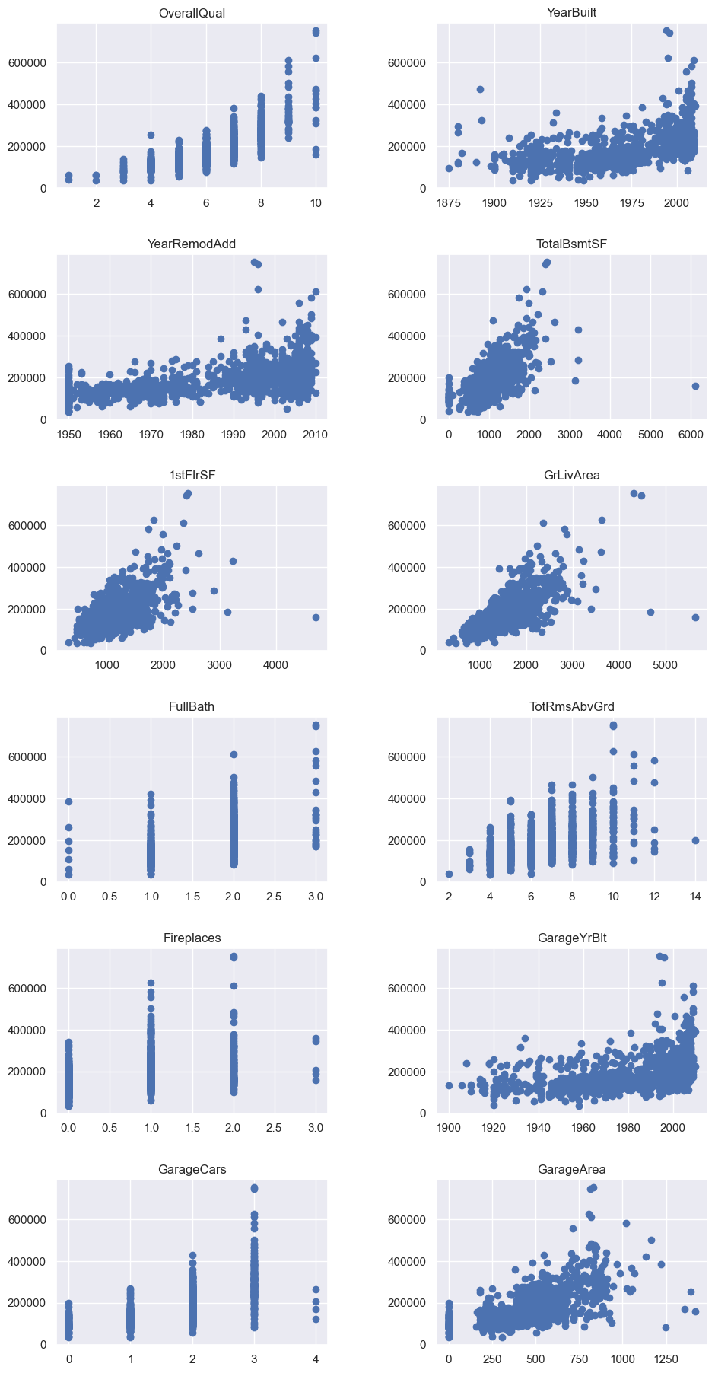

Slide 7
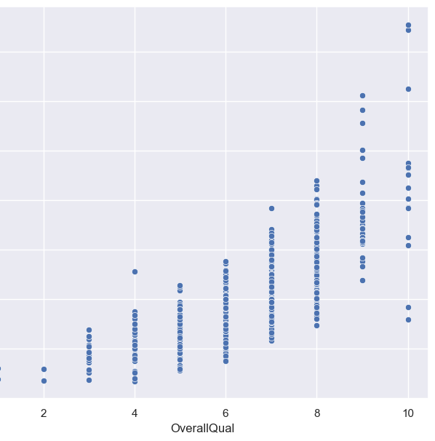
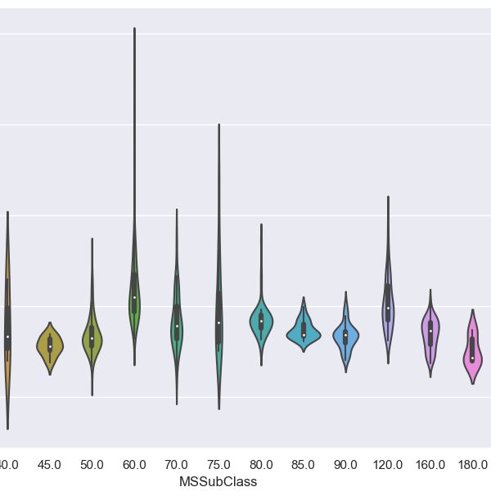

Slide 8
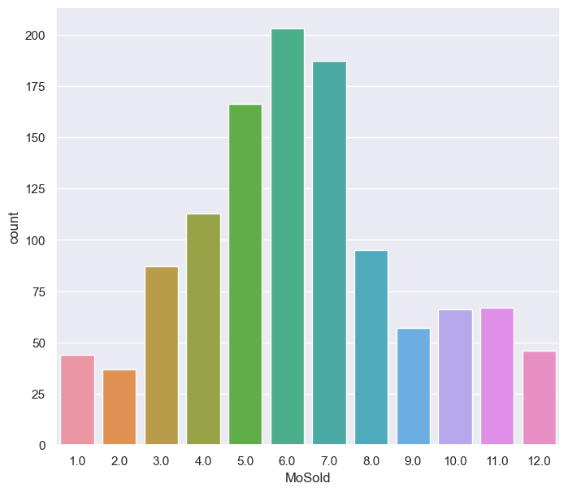
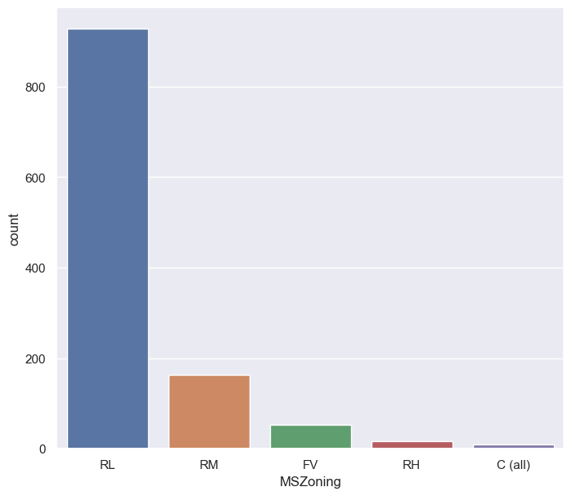

Slide 9
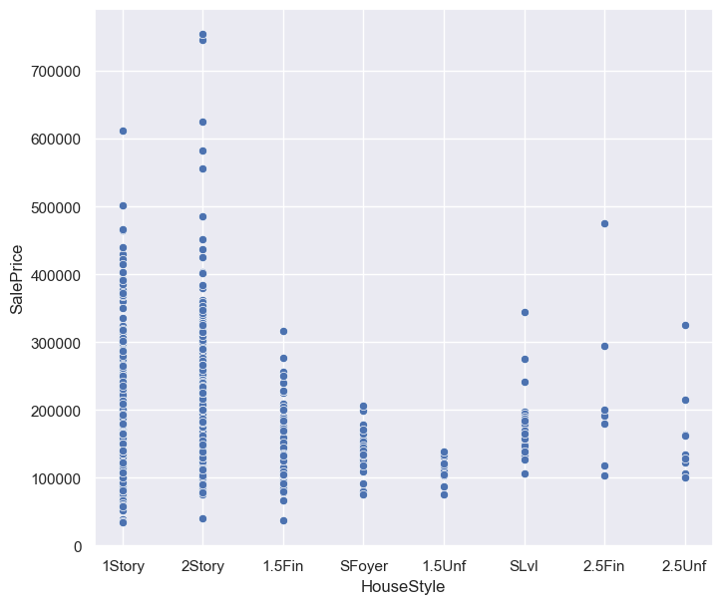
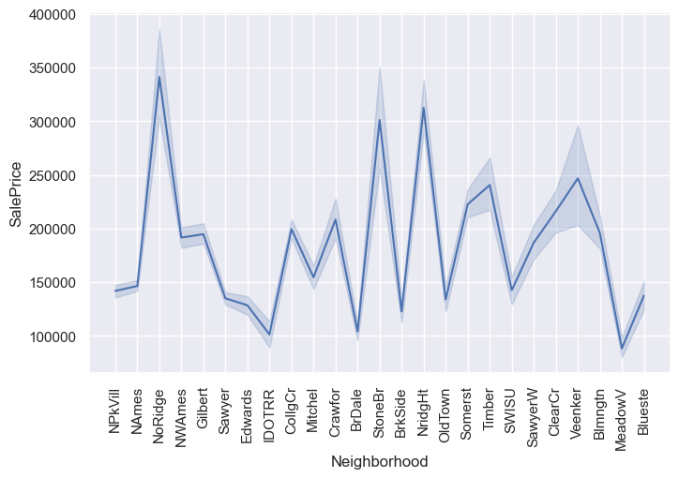

Slide 10
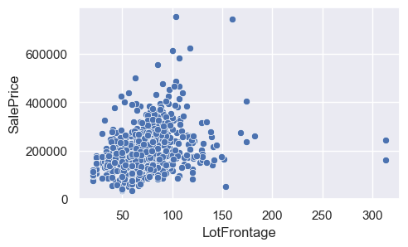
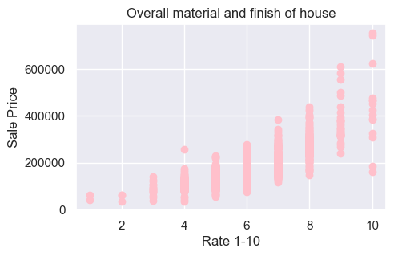

Slide 11
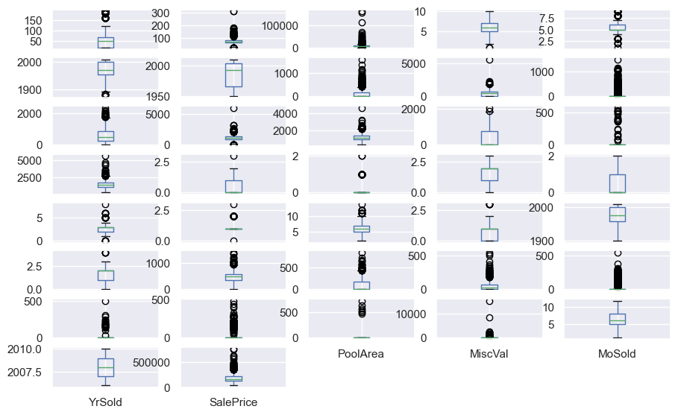

Slide 12
STEPS:
To handle null values, I replaced nan values in categorical features with ‘Unknown’ and used KnnImputer to deal with nan values in numeraical values.
I removed outliers present in the dataset using zscore and threshold as 5 and later normalized dataset using ‘np_log’.
I created dummy features to encode categorical variables.
After pre processing I split the data into train and test and created X_train,y_train, X_test and y_test.
I used various algorithms to find the best and most accurate algorithm, where I found that regularizing model LassoCV was the best and most accurate model with accuracy of ~90%.

Slide 13
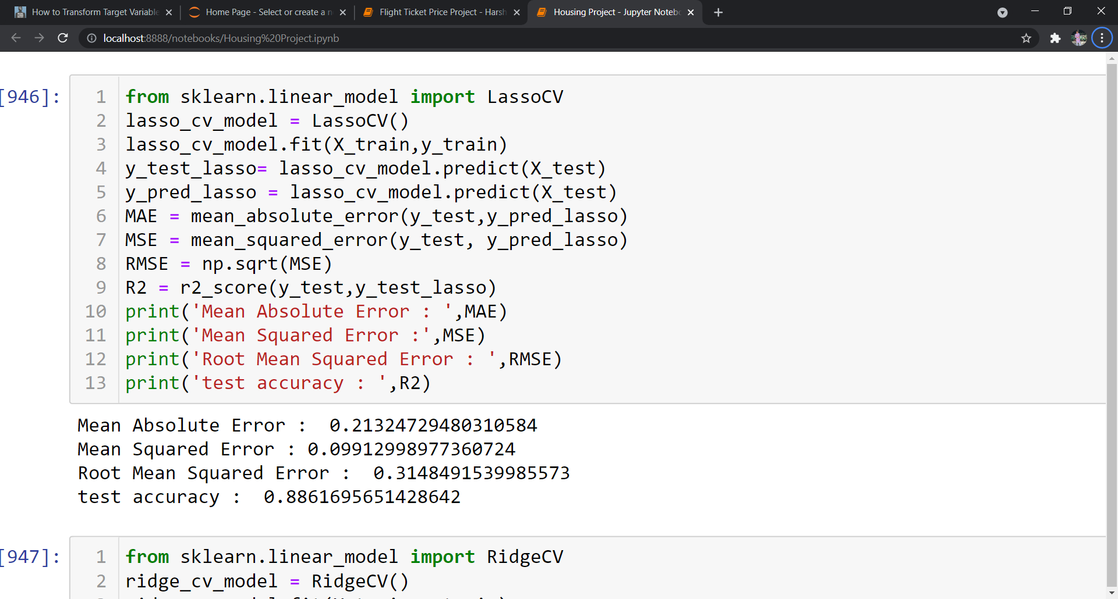
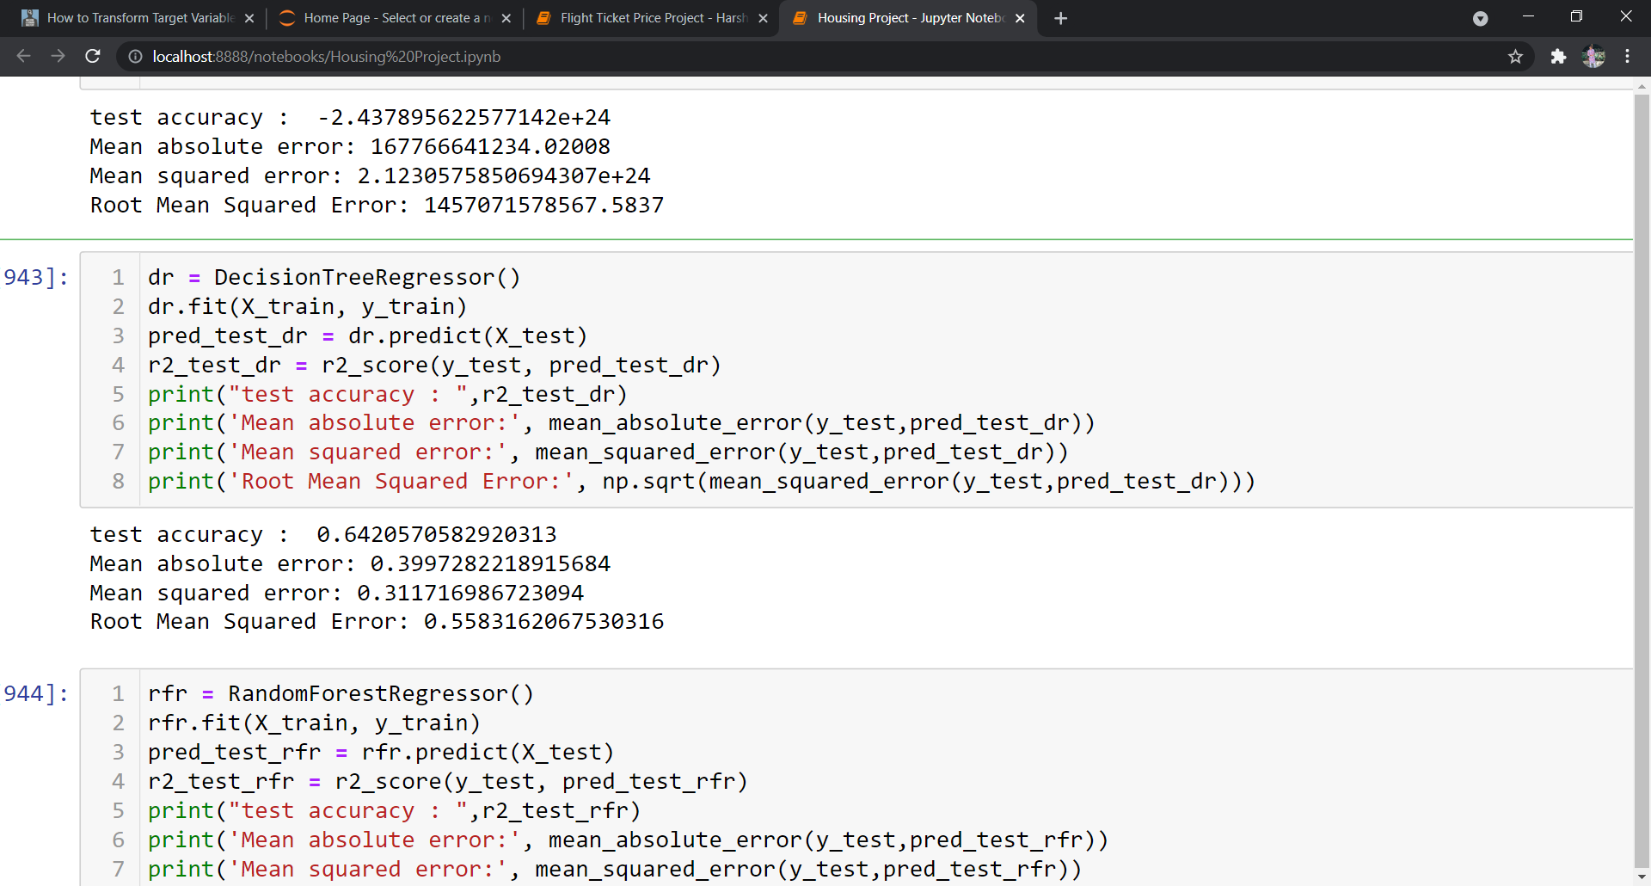
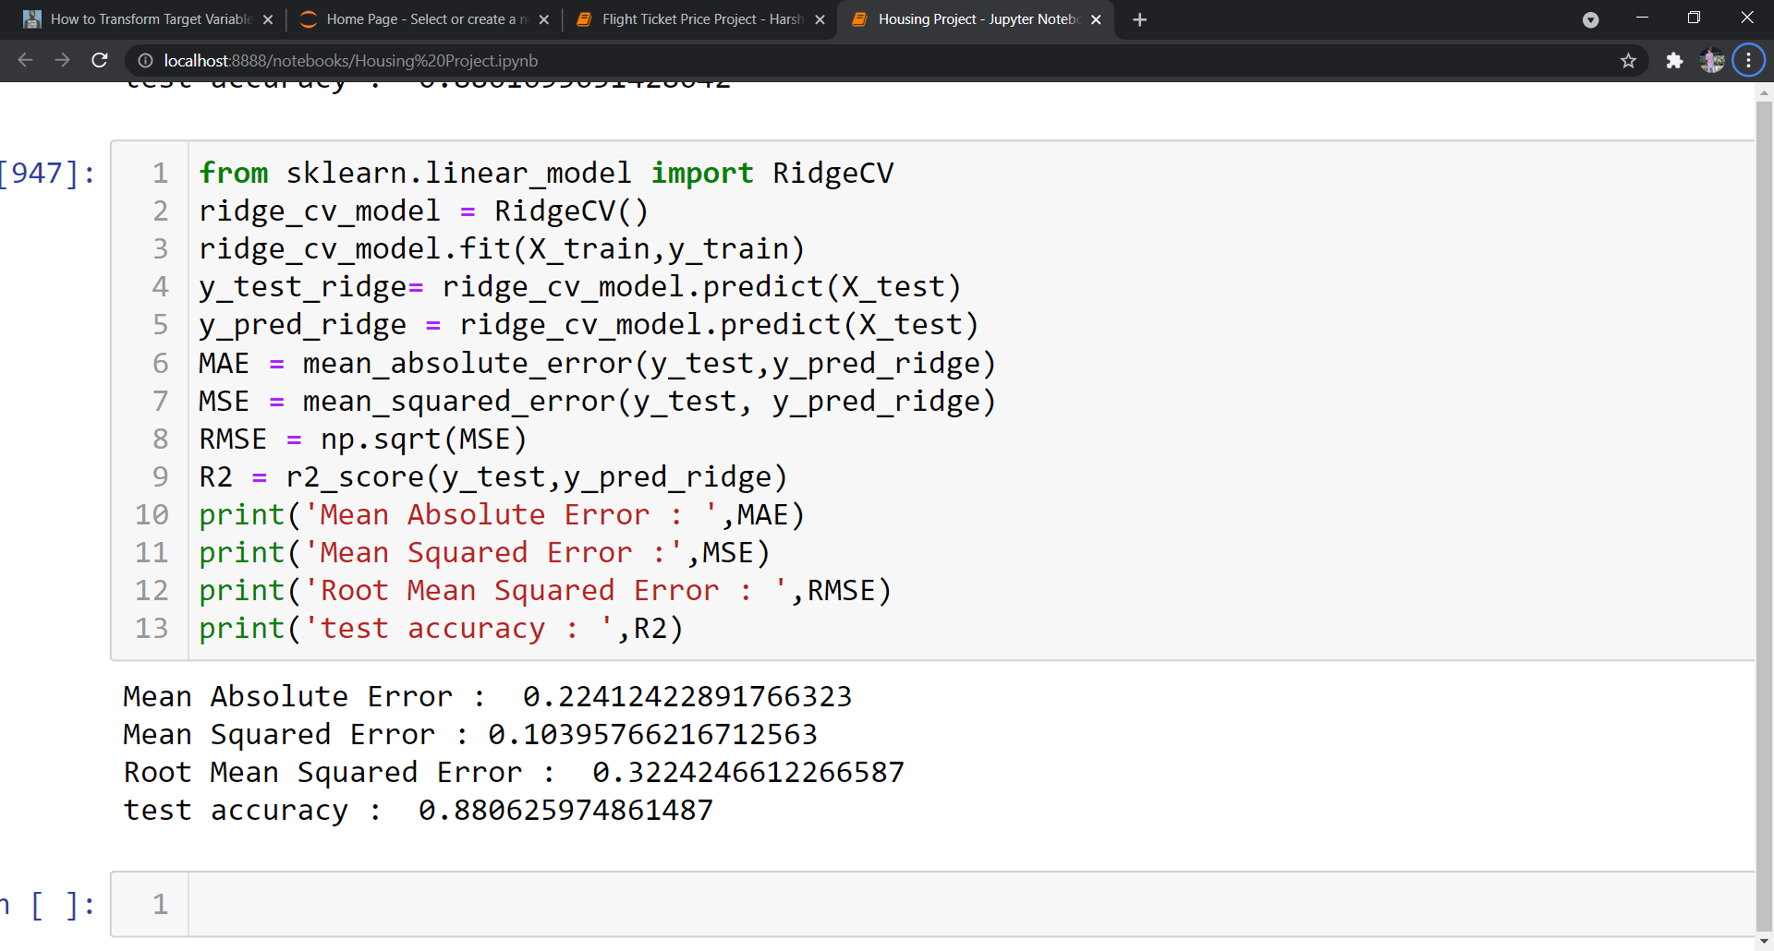
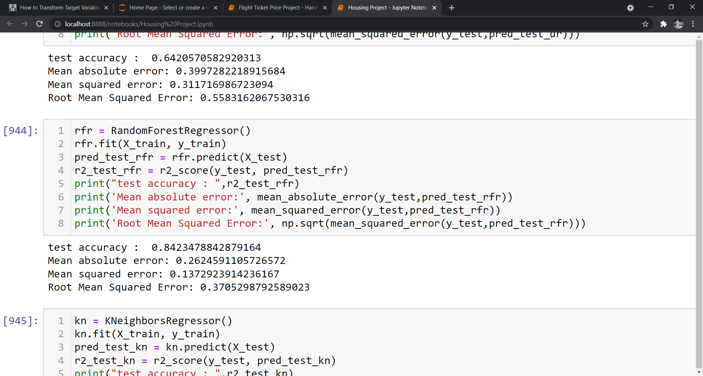
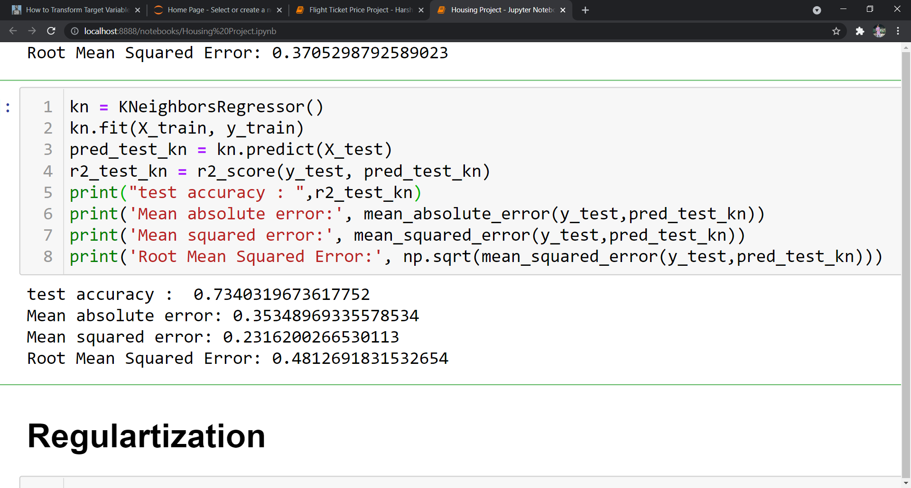
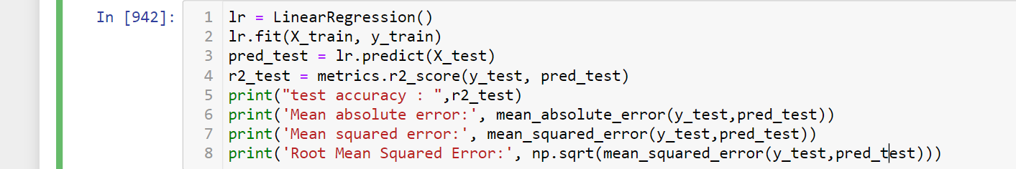

Slide 14
Resources Used:
Jupyter Notebook - The whole project was done in jupyter notebook which provides python environment.
Pandas and Numpy - These libraries which are most important for an predictive analysis project. These libraries provide a function of shaping the data, importing the data and viewing the data.
Matplotlib and Seaborn – These libraries were used for visualising the data in the entire project. All the visualization done in the project were done using either one of these libraries.
Scipy - Scipy library was only used to import zscore to remove outliers present in the dataset.
Sklearn – This library was the most used library as compared to other libraries. This library has been used in pre-processing for imputing numerical null values and for scaling the dataset. Later it was widely used for importing algorithms for machine learning and predicting.

Slide 15
Conclusion
Findings from the project was that many factors play an important for deciding the prices of houses in Australia. There were many nan values present in the dataset but were handled smoothly. At the end of the project key findings were that LassoCV came out to be the best model for predicting house prices followed by LinearRegression and RandomForestRegressor.
I learnt many things while working on this project. Visualizations can help a lot for feature selection. Data cleaning helps us get a better accuracy while predicting the target variable and various algorithms were used in this project which gave a variety of models to used to predict and select the best model for predicting the target variable. Working with many features and there were train and test two different csv files so had to work a lot behind getting better model.
Limitations of this project are that it can be used for a small dataset only and not for larger dataset. This prediction can be used only in the location from where it was collected, factors deciding house prices of other countries can be different.

